Slide 1
Calculation of Electricity bill

Slide 2
Problem statement
Write a java program to calculate electricity bill of a costumer. It considers all the components of bill formation like minimum bill for a meter, tax, additional usage fine etc.

Slide 3
Objectives Of Defined Problem Statement: -
The main objective of the program is to calculate the electricity bill. In this program customers are classified into three types 1. Industrial user, 2. Commercial user and 3. Public user.
The Industrial user is having 1000 rupees as maintenance charge and amount to be paid is calculated using formula
The Commercial user is having 300 rupees as maintenance charge and amount to be paid is calculated using formula
The public user is having 300 rupees as maintenance charge and up amount to be paid is calculated using formula
For termination of the program user must enter the choice as 4 then the program comes to an end by displaying appropriate message.

Slide 4
Methodology (pseudo code): -
Display the choices
Step 1: INDUSTRIAL USER 2:COMMERCIAL USER 3:PUBLIC USER
Step 2: Input of choice
Step 3: Switch(choice)
Case 1:- input of units used
If units up to 1500
Calculate amt =1000+(8*unit)

Slide 5
Else If units from 1500 to 3500
Calculate amt =1000+(9*unit)
Else If units from 3500 to 5000
Calculate amt =1000+(10*unit)
Else if units above 5000
Calculate amt =1000+(12*unit)
Break
Case 2:- input of units used
If units up to 1000
Calculate amt =500+(6*unit)
Else If units from 1000 to 1500
Calculate amt =500+(7*unit)
Else If units from 1500 to 2500
Calculate amt =500+(8*unit)
Else if units above 2500
Calculate amt =500+(10*unit)
Break

Slide 6
Case 3 :- input of units used
If units up to 100
Calculate amt =300+(3*unit)
Else If units from 100 to 350
Calculate amt =300+(4*unit)
Else If units from 350 to 500
Calculate amt =300+(5*unit)
Else if units above 500
Calculate amt =300+(8*unit)
Break
End of switch
Step 4: Display amount
End of for
Step 5:- End

Slide 7
Implementation details:-
package pro;
import static java.lang.System.exit;
import java.util.Scanner;
public class Pro {
public static void main(String[] args) {
int amt=0,unit=0;
Scanner scan =new Scanner (System.in);
For ( ; ;) {
System.out.println(" 1: INDUSTRIAL USER
2: COMMERCIAL USER 3: PUBLIC USER 4: EXIT " ); /* display the choices */
System.out.println("ENTER YOUR CHOICE");
int var = scan.nextInt (); /* Input of choice */

Slide 8
switch(var){
case 1: System.out.println("Enter the units used");
unit=scan.nextInt(); /* input of units used */
if(unit<=1500) {
amt=1000+(8*unit); /* calculate amount*/
}
else if(unit>1499 && unit<3500) {
amt=1000+(9*unit); /* calculate amount*/
}
else if(unit>3499 && unit<5000) {
amt=1000+(10*unit); /* calculate amount*/
}
else if(unit>=5000) {
amt=1000+(12*unit); /* calculate amount*/
}
break;

Slide 9
case 2: System.out.println("Enter the units used");/* input of units used */ unit=scan.nextInt();
if(unit<=1000) {
amt=500+(6*unit); /* calculate amount*/
}
else if(unit>999 && unit<1500) {
amt=500+(7*unit); /* calculate amount*/
}
else if(unit>1499 && unit<2500) {
amt=500+(8*unit); /* calculate amount*/
}
else if(unit>=2500) {
amt=500+(10*unit); /* calculate amount*/
}
break;

Slide 10
case 3: System.out.println("Enter the units used");
unit=scan.nextInt(); /* input of units used */
if(unit<=100) {
amt=300+(3*unit); /* calculate amount*/
}
else if(unit>99 && unit<350) {
amt=300+(4* unit); /* calculate amount*/
}
else if( unit>350 && unit<500) {
amt=300+(5* unit); /* calculate amount*/
}
else if( unit>=500) {
amt=300+(8* unit); /* calculate amount*/
}
break;

Slide 11
case 4:System.out.println("");
System.out.println("THANK YOU");
Exit (0) ; /*terminating the program */
default:System.out.println("INVALID CHOICE");
}
System.out.println("--------------------------------------------------");
System.out.println("**************************************");
System.out.println("-------------------------------------------------");
System.out.println(" H E S C O M ");
System.out.println(" ELECTRICITY BILL ");
System.out.println();
System.out.println("NUMBER OF UNIT(S) USED = "+unit+" units" );/**/
System.out.println("THE AMOUNT TO BE PAID IS = Rs."+amt ); /*display amount */

Slide 12
System.out.println();
System.out.println(" THANK YOU ");
System.out.println("--------------------------------------------------");
System.out.println("************************************");
System.out.println("-------------------------------------------------");
System.out.println();
}
}
}

Slide 13
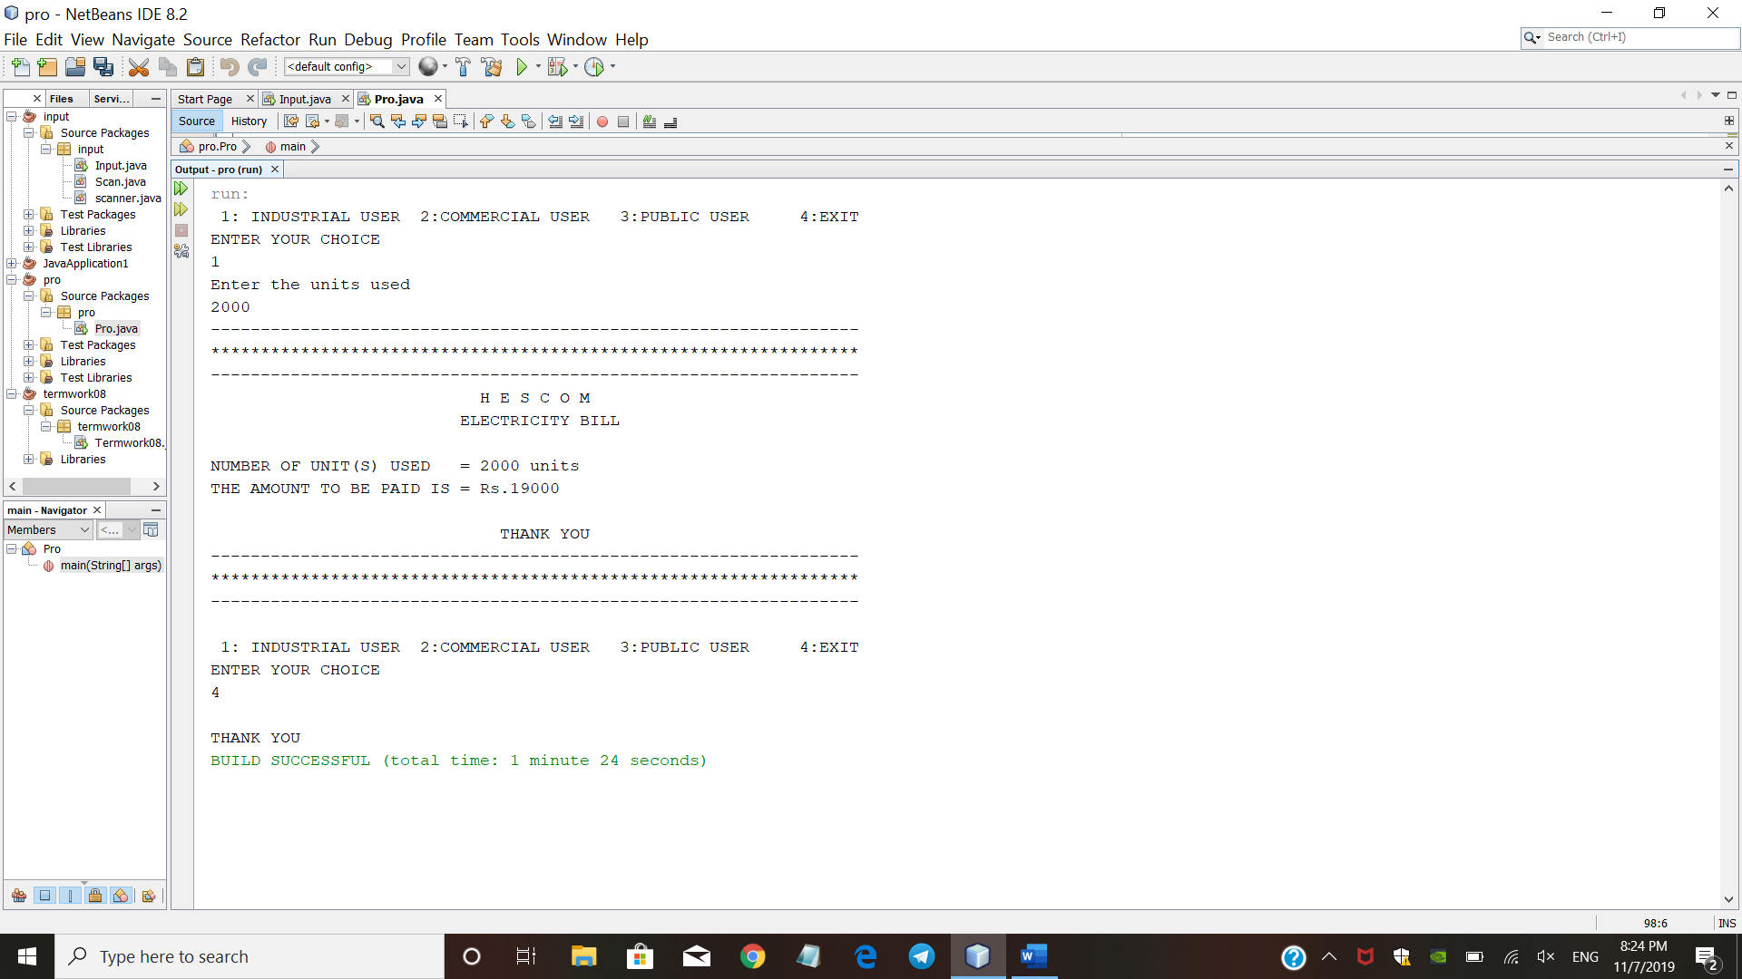

Slide 14


Slide 15


Slide 16
THANK YOU

